Slide 1

Global YouTube EDA

Slide 2
1. Business Problem

Slide 3

Business Problem
The Global YouTube Statistics dataset comprises records of YouTubers, including metrics such as channel subscribers, uploads, views, earnings, and more.
The primary objective of this project is to conduct an in-depth Exploratory Data Analysis (EDA) to uncover trends, generate impactful data visualizations, and deliver actionable insights.
These insights will offer valuable suggestions to help YouTubers enhance their content, boost revenue, and expand their global presence

Slide 4
2. Analysis and Findings

Slide 5
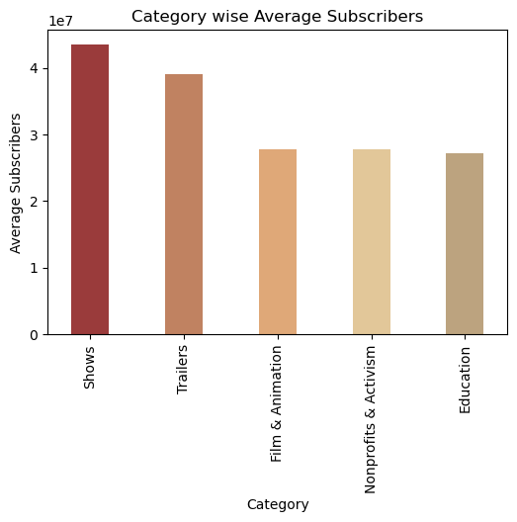
1. Category wise Average subscribers
The bar chart represents the average number of subscribers across different YouTube content categories
Shows: This category has the highest average number of subscribers, exceeding 40 million, indicating its strong popularity and wide appeal to a large audience.
Trailers: Close behind, the Trailers category also boasts a significant average subscriber count, likely reflecting the broad interest in movie, TV, or game trailers.
Film & Animation: This category maintains a solid average of over 30 million subscribers, highlighting the appeal of creative and visual content like animated films or short films.
Nonprofits & Activism: Despite being focused on social causes, this category also commands a respectable average of around 30 million subscribers, indicating strong engagement in content that promotes social change or activism.
Education: The Education category has a similar average subscriber count to Nonprofits & Activism, suggesting that informative, instructional content has a significant following, though slightly lower compared to Shows and Trailers.

Slide 6
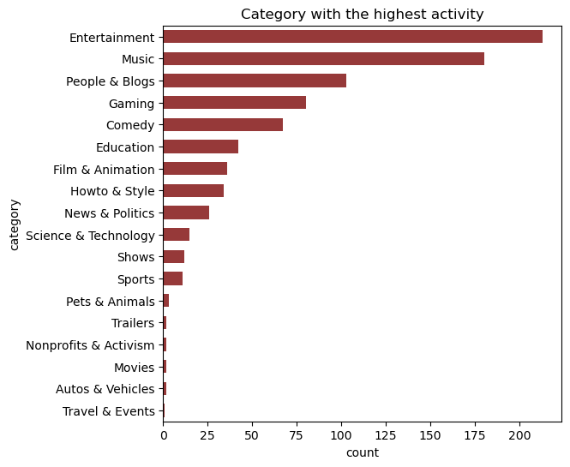
2. Category with Highest activity
The bar chart represents the categories with the highest activity, likely represented by the count of occurrences for each category.
Top categories: Entertainment has the highest activity, with around 200 occurrences. This indicates that Entertainment is the most active category in this dataset. Music follows as the second most active category, with a count slightly lower than Entertainment
Moderate Activity Categories: People & Blogs and Gaming are also popular categories, with substantial counts compared to others. Comedy has a notable count but is less active compared to the top categories.
Lower Activity Categories: Education, Film & Animation, and How to & Style fall into the mid-range in terms of activity. News & Politics and Science & Technology have lower activity compared to the more general and entertainment-oriented categories.
Least Active Categories: Categories like Shows, Sports, Pets & Animals, Trailers, Nonprofits & Activism, Movies, Autos & Vehicles, and Travel & Events have the least activity, with very low counts.

Slide 7
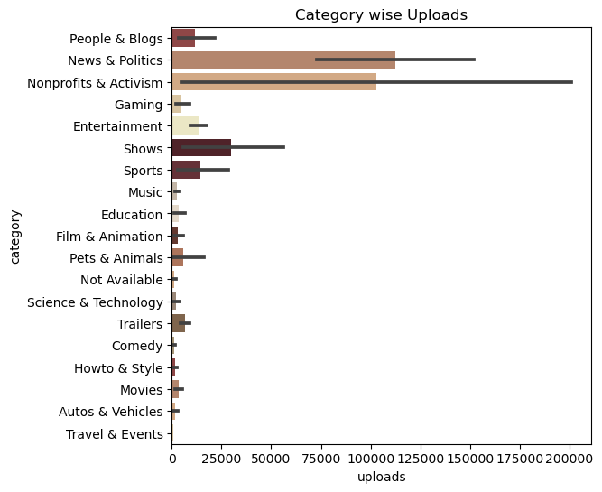
3. Category wise uploads
This visual is a horizontal bar chart that displays the number of uploads across different content categories.
Top categories: The Nonprofits & Activism category leads in the number of uploads, nearing 200,000, indicating a strong focus on content centered around social causes and activism. The News & Politics category follows closely, reflecting a substantial volume of content related to current events, news, and political commentary. Meanwhile, the People & Blogs category exhibits a moderate level of uploads, suggesting that personal vlogs and blogs are also popular, though not to the same extent as the aforementioned categories
Moderate categories: The Shows category has a considerable number of uploads, likely reflecting the presence of episodic content or serialized programming. The Sports category also shows a moderate volume of uploads, indicating a consistent flow of content related to sports activities, events, and discussions.
Low upload categories: : Categories like Movies, Autos & Vehicles, Travel & Events, and Trailers have very low numbers of uploads. This may indicate niche content areas or less frequent content creation compared to other categories.
Other categories: Categories like Education, Science & Technology, and Music have relatively low uploads compared to the top categories. This could suggest either a lower interest or fewer creators in these areas.

Slide 8
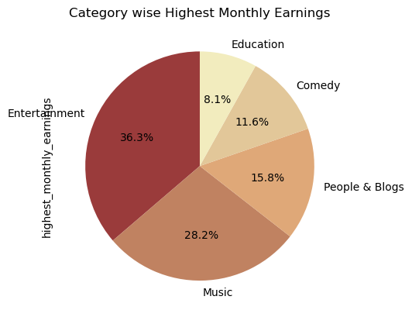
4. Category wise Highest monthly earnings
The pie chart is displaying the distribution of highest monthly earnings by category.
Entertainment has the highest share of earnings at 36.3%. Music follows with 28.2%. People & Blogs constitutes 15.8% of the earnings. Comedy accounts for 11.6%. Education has the smallest share at 8.1%.
Dominant Categories: Entertainment and Music are the top-earning categories. These genres often have high viewership and engagement, leading to better ad revenue and sponsorship deals.
The entertainment category significantly outperforms other categories in terms of earnings, indicating the strong monetization potential in this segment. Music also holds a substantial share, reflecting its global appeal and high engagement rates
Smaller Categories: Categories like People & Blogs and Comedy, while popular, generate relatively lower earnings compared to Entertainment and Music. Education has the smallest share, suggesting either fewer monetization opportunities or a smaller audience base in comparison to other categories

Slide 9
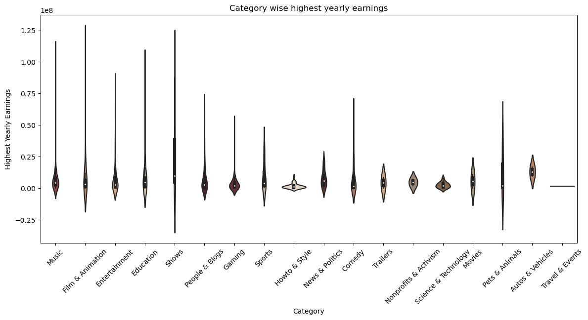
5. Category wise Highest yearly earnings
The violin plot represents the category wise highest yearly earnings
Categories such as Music, Film & Animation, and Entertainment show a broad distribution with several high-earning outliers. The Shows category has the widest spread, indicating a highly variable range of earnings.
Categories like How to & Style and Nonprofits & Activism have a more concentrated distribution, suggesting consistent earnings among these channels. Gaming and Education categories also show a fairly concentrated earnings range with fewer outliers.
Outliers: Several categories, such as Music, Film & Animation, and Shows, have significant outliers. These indicate that some channels in these categories generate exceptionally high earnings compared to the rest. The Pets & Animals and Autos & Vehicles categories also show some variability but with fewer extreme outliers.

Slide 10
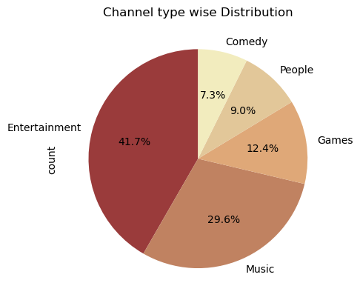
6. Channel type Distribution
The pie chart shows the distribution of different channel types.
Dominant Channel Type: Entertainment channels have the largest share, making up 41.7% of the total distribution. This suggests that entertainment is the most popular channel type in this dataset.
Significant Channel Types: Music channels are the second most common type, constituting 29.6% of the total. Games channels account for 12.4% of the distribution.
Smaller Categories: People channels make up 9.0% of the distribution. Comedy channels have the smallest share at 7.3%

Slide 11
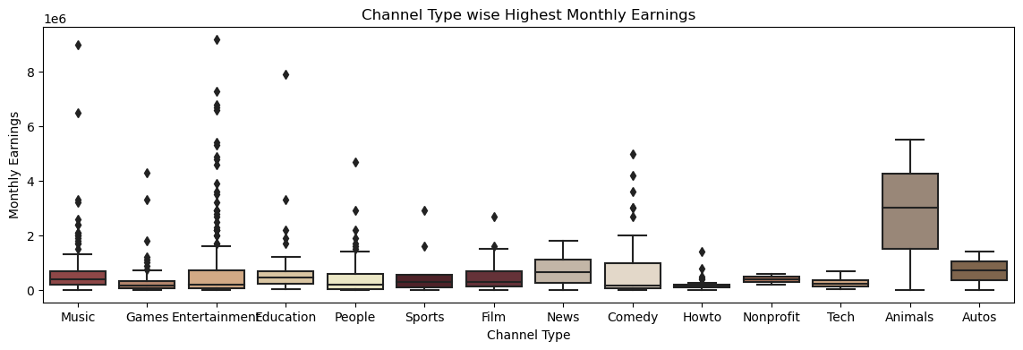
7. Channel type Highest Monthly earnings
The box plot shows the distribution of monthly earnings for various channel types on YouTube
Channel type highest monthly earnings: Tech channels have the highest median monthly earnings, followed by Animals and Entertainment channels.
Channel type with lower monthly earnings: The median earnings of channels like Sports, How-to, and Nonprofit are relatively lower compared to other categories
The length of the boxes indicates the interquartile range (IQR), showing the spread of earnings within each category. The Animals and Entertainment categories have a wider IQR, indicating a greater variation in monthly earnings among channels in these categories
Categories like Games and How-to have a narrower IQR, suggesting less variation in their monthly earnings.
Outliers: Categories such as Music, Entertainment, and Games have a high number of outliers, suggesting that a few channels in these categories are exceptionally profitable.

Slide 12
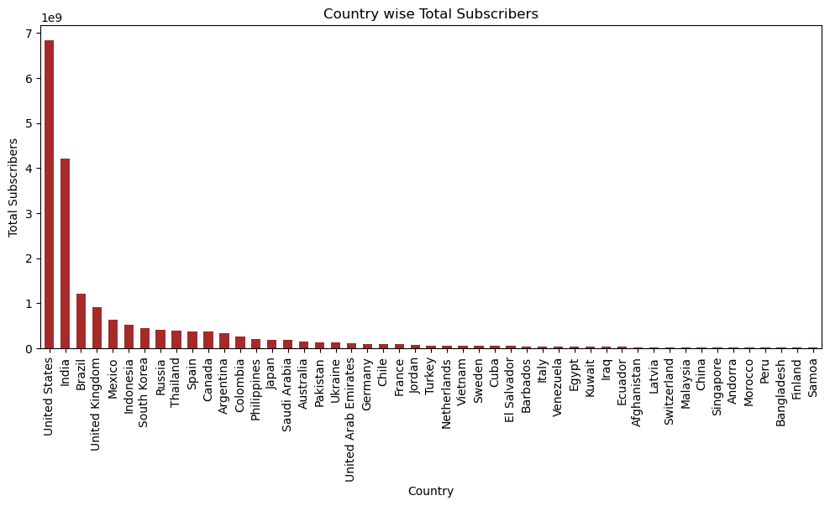
8. Country wise subscribers
The bar chart represents the total subscribers for each country
Dominant Country: The United States has the highest number of total subscribers, significantly more than any other country. Its bar is much taller than the others, indicating a very large subscriber base.
Top Countries: After the United States, the countries with the highest subscriber counts are India, Brazil, and the United Kingdom. These countries have a noticeable drop in subscriber numbers compared to the United States but still stand out among the rest.
Other Countries: The remaining countries have relatively small numbers of subscribers, as indicated by the short bars. These include a wide range of countries from different regions, such as Indonesia, Mexico, and South Korea, among others.

Slide 13
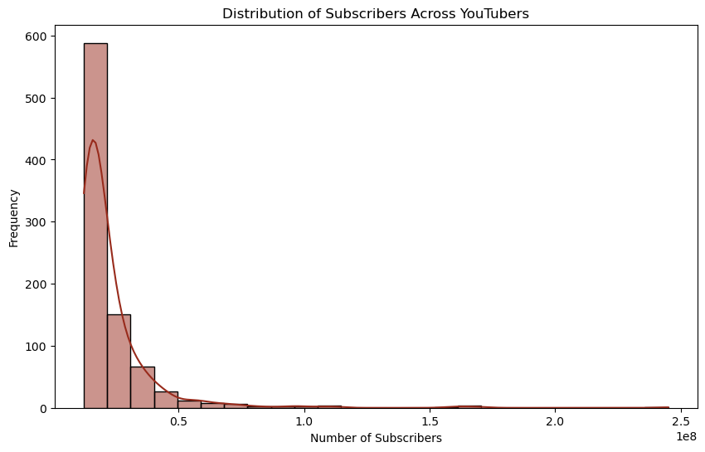
9. Distribution of subscribers
The histplot represents the distribution of subscribers across YouTubers
The plot shows a clear right-skew, meaning that the majority of YouTubers have relatively low subscriber counts, while a few channels have very high subscriber numbers
Most of the data is concentrated in the first few bins (toward the left side of the chart), indicating that a large number of YouTubers have subscribers in the lower range

Slide 14
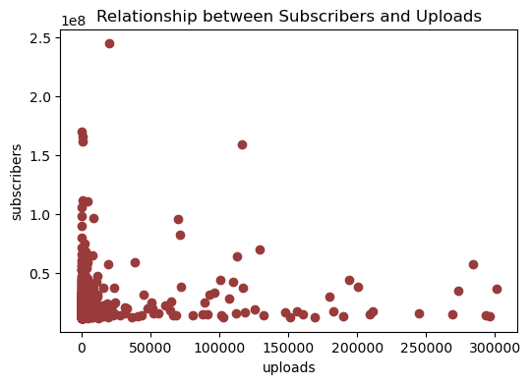
10. Relation between subscribers and uploads
The scatter plot shows the relationship between subscribers and uploads
The scatter plot shows a large concentration of data points towards the lower left corner, indicating that many channels have fewer uploads and subscribers.
The number of channels significantly decreases as the number of uploads increases beyond 50,000
Outliers: There are a few outliers visible on the plot, where channels have an exceptionally high number of subscribers (over 200 million) despite having a relatively low number of uploads (around 50,000). Another set of outliers includes channels with high uploads (above 100,000) but moderate subscriber counts.

Slide 15
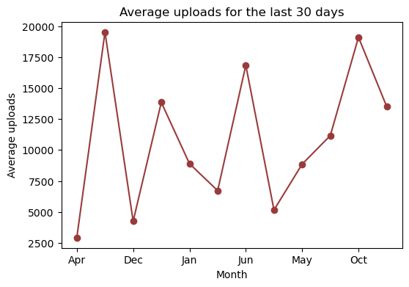
11. Average uploads
The bar chart represents the total subscribers for each country
Dominant Country: The United States has the highest number of total subscribers, significantly more than any other country. Its bar is much taller than the others, indicating a very large subscriber base.
Top Countries: After the United States, the countries with the highest subscriber counts are India, Brazil, and the United Kingdom. These countries have a noticeable drop in subscriber numbers compared to the United States but still stand out among the rest.
Other Countries: The remaining countries have relatively small numbers of subscribers, as indicated by the short bars. These include a wide range of countries from different regions, such as Indonesia, Mexico, and South Korea, among others.

Slide 16
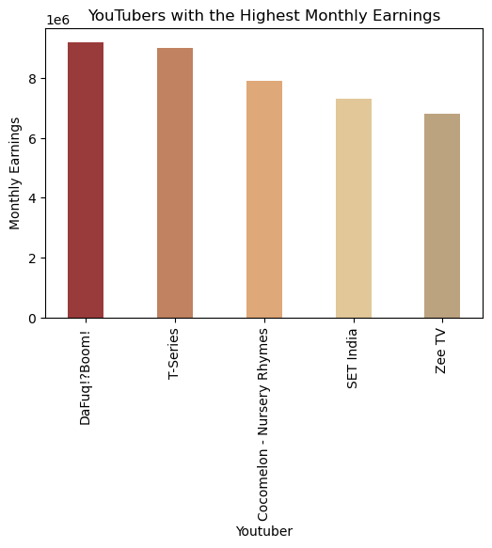
12. YouTubers with Highest monthly earnings
This visual is a bar chart representing the monthly earnings of the top five YouTubers with the highest earnings
Top earning YouTubers: Dafuq!?Boom! has the highest monthly earnings, slightly above 9 million. This indicates a strong performance, likely due to high views, ad revenue, or sponsorship deals.
Other high earning YouTubers: T-Series follows closely with monthly earnings slightly below Dafuq!?Boom!, showcasing its popularity and extensive reach, especially in the Indian market. Cocomelon - Nursery Rhymes ranks third, reflecting the high demand for children’s content on YouTube. SET India and Zee TV also feature in the top five, highlighting the dominance of Indian entertainment channels on the platform.

Slide 17
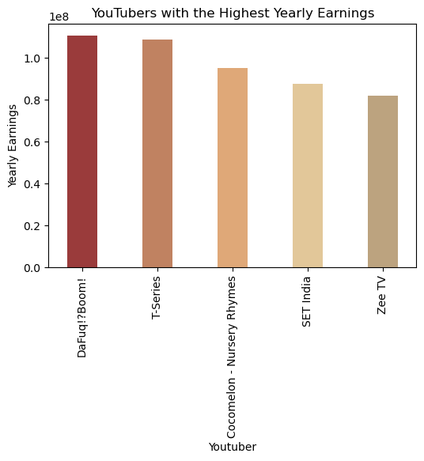
13. YouTubers with Highest yearly earnings
The above line chart represents the YouTubers with highest yearly earnings.
Highest Earner: DaFuq!?Boom! appears to have the highest yearly earnings, exceeding 1.0 x 10^8 (100 million) in the represented currency
Top Contenders: T-Series closely follows, with earnings nearly equal to DaFuq!?Boom!. Cocomelon - Nursery Rhymes is the third highest, with earnings slightly below T-Series
Other Significant Channels: SET India and Zee TV are fourth and fifth, respectively. Their earnings are lower than the top three but still substantial.

Slide 18
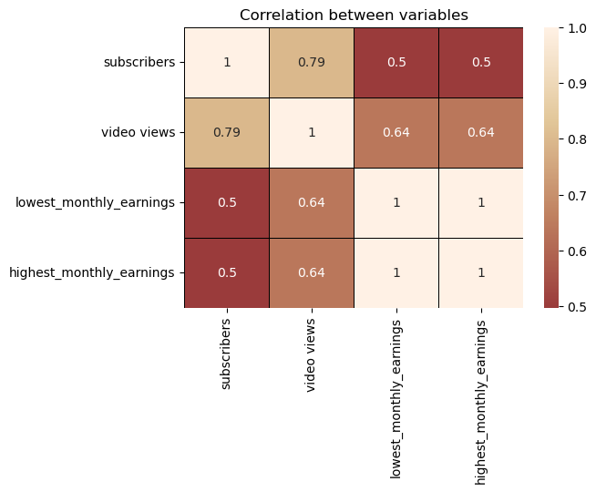
14. Correlation between subscribers, views and earnings
This visual is a correlation matrix, which shows the relationships between different variables using correlation coefficients.
The values range from -1 to 1. 1 indicates a perfect positive correlation while -1 indicates a perfect negative correlation. 0 means no correlation.
Subscribers & Video Views: Correlation of 0.79. This is a strong positive correlation, indicating that as the number of subscribers increases, the number of video views also tends to increase. Video Views & Monthly Earnings (both lowest and highest): Correlation of 0.64. This suggests a moderate positive relationship, meaning that higher video views are associated with higher monthly earnings. Subscribers & Monthly Earnings (both lowest and highest): Correlation of 0.5. This indicates a moderate positive relationship, suggesting that an increase in subscribers is moderately associated with an increase in monthly earnings. Lowest & Highest Monthly Earnings: Correlation of 1
The strong correlation between subscribers and video views suggests that increasing subscriber count can significantly boost video views, which is expected as subscribers are usually more engaged viewers.
The moderate correlation between video views and monthly earnings implies that more video views are generally associated with higher earnings, which makes sense in most ad-revenue-based platforms.

Slide 19
3. Insights and Recommendations

Slide 20
Insights and Recommendations
Creators should consider focusing on Shows or Trailers to reach larger audiences. However, those in Nonprofits & Activism and Education can still succeed with high-quality, niche content.
For YouTubers looking to expand their reach, tapping into countries outside of the US, India, and the UK, with improved digital literacy and infrastructure, could offer growth opportunities.
Channels in Entertainment, Music, Tech, and Animals can maximize earnings potential with consistent content and brand partnerships.
Creators in niche categories like Education should explore diversified revenue models beyond ad revenue, such as sponsorships or memberships.
Categories with fewer uploads, like Movies, Autos & Vehicles, and Travel & Events, present opportunities for content creators to fill gaps in these markets.
Creators should produce content that appeals to a global audience by incorporating multilingual content or localizing videos for different regions, especially in countries with growing digital access outside the top markets like the US, India, and the UK.
Creators can use insights from their channel’s performance data, like the best-performing video types and viewer demographics, to tailor content strategies for higher engagement and better audience retention

Slide 21
Thank You

